Slide 1



ARRAYS
-A FUNDAMENTAL DATA STRUCTURE
Team Members:
Suhani Gupta (2024d1r008)
Parul Singla (2024d1r001)
Sahal Imran (2024d1r005)
Sakrite Devi (2024d1r003)
Jyoti Verma (2023d1r012)
Model Institute of
Engineering & Technology
Notes:
Presentation slide for courses, classes, lectures et al.

Slide 2
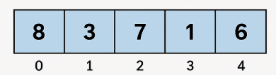
Arrays
An array is a linear data structure.
An array is defined as the fixed-sized collection of elements of the same data type, stored in contiguous memory locations, and accessed using an index.
Why Arrays are Needed:
To store multiple values of the same type under a single variable name.
Simplifies data management compared to using multiple separate variables.
Allows random access to any element using its index.
Real-life analogy: Think of seats in a movie hall numbered consecutively — each seat is right next to the other without gaps.

Slide 3
Characteristics of Arrays
Fixed Size (Static Memory Allocation) Once declared, the size of the array cannot be changed.
Homogeneous Elements (Same Data Type) All elements in the array must be of the same data type (e.g., all integers, all floats).
Stored in Contiguous Memory Locations Elements are placed one after another in memory without gaps.
Array Element
Each item stored in an array is called an element.
Random Access Using Index Any element can be accessed directly using its index in constant time O(1) and indexing usually starts from 0
Array Size
It is the total number of elements it can hold

Slide 4
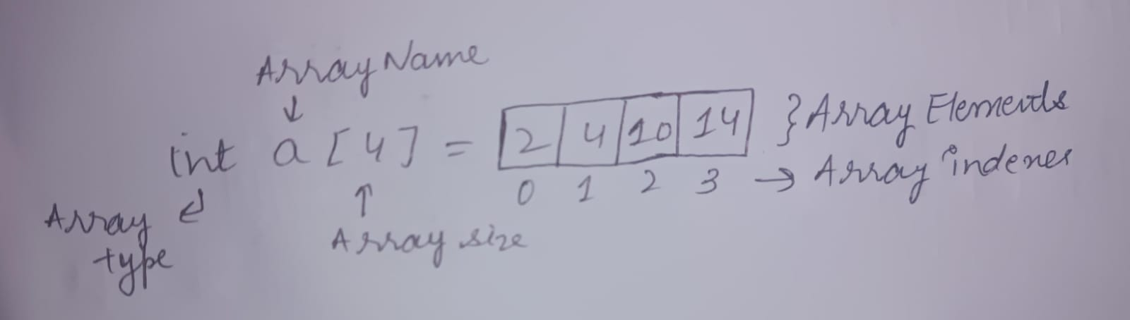
Representation of an Array
Here,
Array index starts from 0.
Array length is 4 that means it can store 4 elements.
And, each item can be accessed via its index.

Slide 5
Memory Representation of Arrays
How Elements are Stored:
Array elements are stored in contiguous memory locations (next to each other).
This allows fast random access because the address of any element can be calculated directly.
Formula for Address Calculation:
Address=Base Address+(Index×Size of each element)
Example: If Base Address = 1000, Index = 3, and size of int = 4 bytes: Address=1000+(3×4)=1012
Memory Layout Diagram:
Index 0 1 2 3 4
Value 10 20 30 40 50
Addr 1000 1004 1008 1012 1016

Slide 6
Array Declaration, Initialization and Accessing elements
Array Declaration : Allocating memory for an array of a given size.
int arr[5]; // Declaration
Array Initialization: Assigning values to an array
int arr[5] = {10, 20, 30, 40, 50}; // Initialization
Accessing Elements: Elements of an array can be accessed by using its index.
printf("%d", arr[2]); // Access 3rd element

Slide 7
Basic Operations on Arrays
Traversal: Visiting each element of the array sequentially.
Insertion: Adding a new element at beginning, middle, or end. It may require shifting elements to create space.
Deletion: Removing an element from a specific index. It requires shifting elements to fill the gap.
Searching: Finding a location of an element in the given value
Sorting: Arranging array elements in a specific order (ascending or descending).

Slide 8
Traversing
Traversing is an operation which means to visit each element atleast once till the end of an array in order to read , print or process specific values in a specific order, ensuring that no element is missed.
Time Complexity:
Best: O(n) – Must visit all elements at least once.
Average: O(n) – Visits each element sequentially.
Worst: O(n) – Still requires checking all elements.

Slide 9
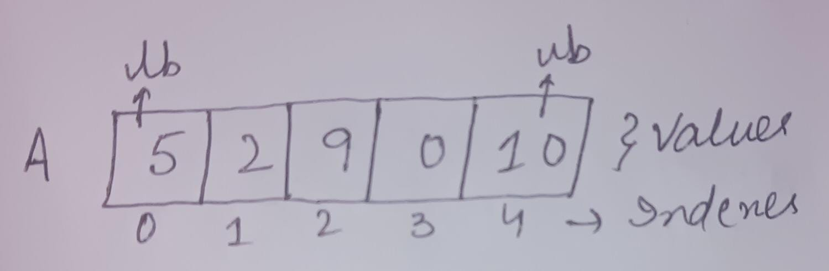
Algorithm
Step 1: Start
Step 2: Set I = lb
Step 3: Repeat Steps 4 & 5 while i<=ub
Step 4: Print a[i]
Step 5: Set I = i+1
[End of loop]
Step 6: Exit

Slide 10
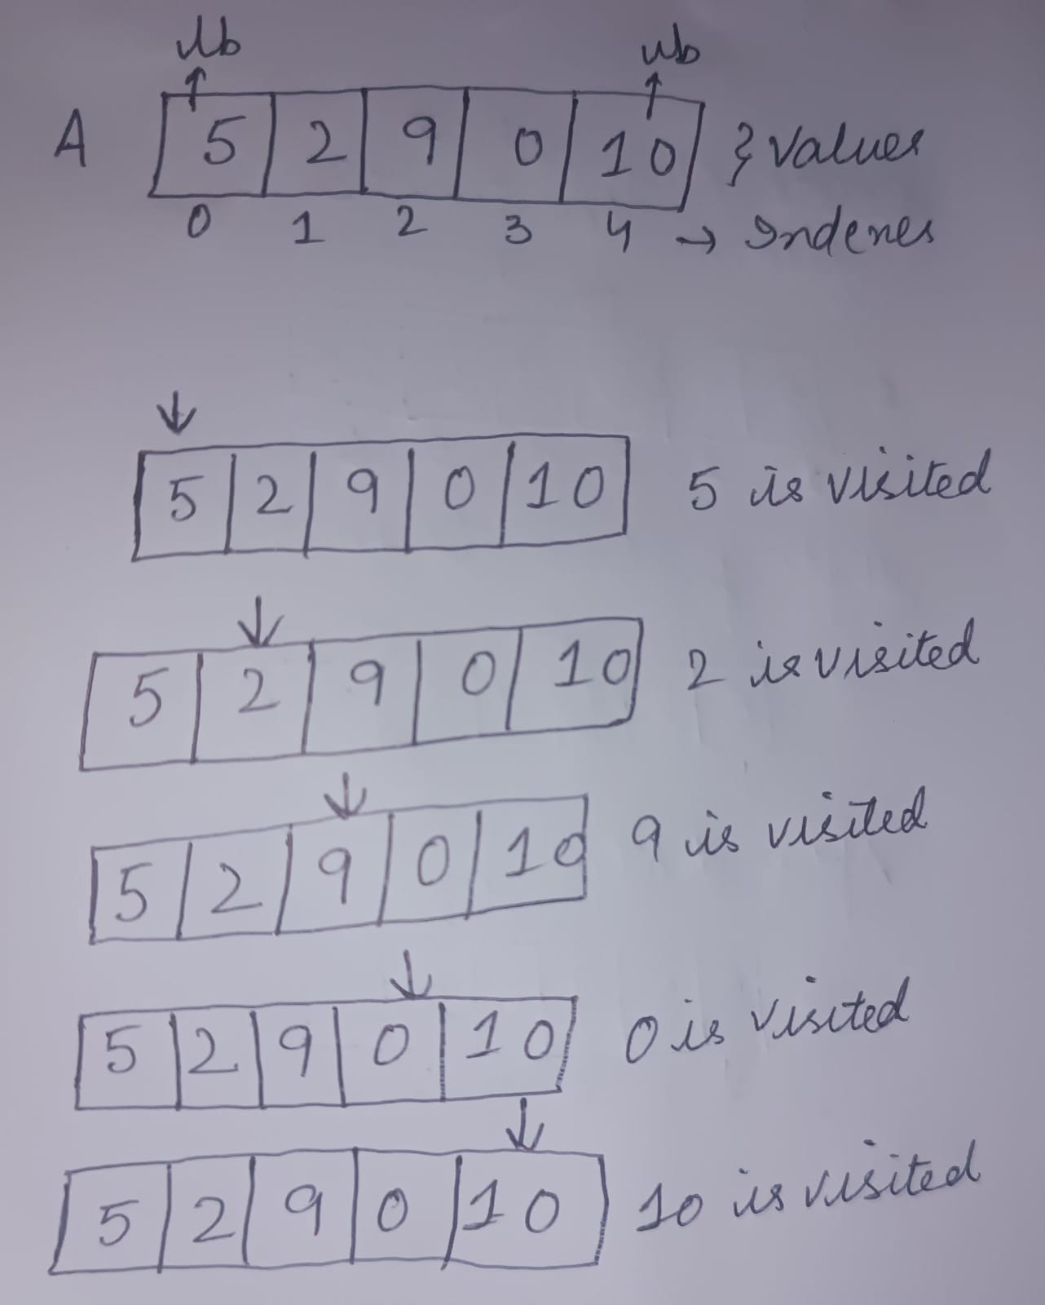
Working

Slide 11
Insertion
Insertion is an operation which means to adding a new element to an already existing array.
Working:
When we create an array, it stores elements in a contiguous manner.
When inserting a new element, the following steps takes place:
a. Identify the position where new elemeny should be inserted.
b. Shift the elements one position forward in order to create the space for the new element.
c . Insert the new element in the correct position.
d. Update the size of an array as the size is incremented by 1.

Slide 12
Based on the requirement, a new element can be inserted:
a. At the beginning: It involves shifting all existing elements one position to the right to create an empty space for the new element at index 0.
Example:
Input: arr[] = [10, 20, 30, 40], ele = 50 Output: [50, 10, 20, 30, 40]
b. At a given position: It involves shifting the elements from the specified position onward one index to the right to make an empty space for the new element. After shifting the elements, the new element is inserted at the target position.
Example:
Input: arr[] = [10, 20, 30, 40], pos = 2, ele = 50 Output: [10, 50, 20, 30, 40]

Slide 13
c. At the End: It involves directly inserting an element at the end of an array if the space is available.
Example:
Input: arr[] = [10, 20, 30, 40], ele = 50 Output: [10, 20, 30, 40, 50]
Time Complexity:
Best Case (at end): O(1)
Worst Case (at beginning): O(n)
Note: Requires shifting elements, which increases cost for large arrays.

Slide 14
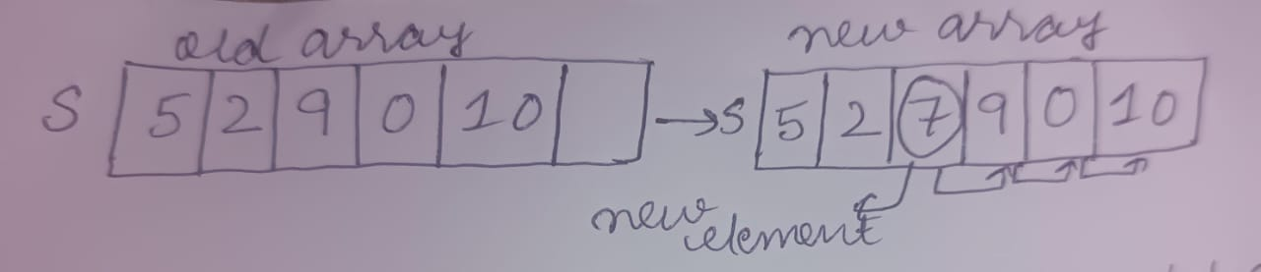
Insertion Algorithm
Step 1: Start
Step 2: Repeat steps 3 to 4 for i = n to k
Step 3: Set S[i+1] = S[i]
Step 4: Set i= i-1
[End of loop]
Step 5: Set S[k] = new
Step 6: Set n = n+1
Step 7: Exit
where, n= Size of an array
k=position where we want to insert an element
new=element that we want to insert

Slide 15
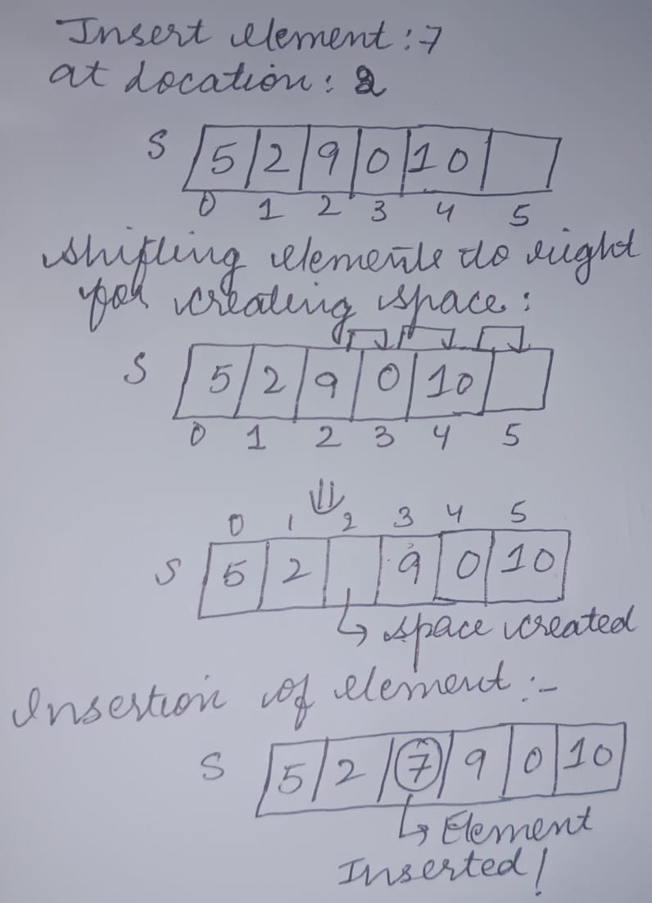
Working

Slide 16
Deletion
Deletion is an operation which means to delete an existing element from an already existing array.
Working:
When we create an array, it stores elements in a contiguous manner.
Deleting an element does not reduce the allocated memory. Instead, it involves the following steps :
a. Identify the position from where we want to delete an element.
b. After deletion, shift the elements after the deleted element one position to the left in order to fill the gap.
c. Update the size of an array as the size is decremented by 1.

Slide 17
Based on the requirement, a new element can be deleted:
a. At the beginning: It involves shifting of all the array elements to the left oby one position in order to fill the gap.
Example:
Input: arr = [10, 20, 30, 40] After deletion: arr = [20, 30, 40]
b. At a given position: Only elements after the index shift left.
Example:
Input: arr = [10, 20, 30, 40], index = 2 After deletion: arr = [10, 20, 40]

Slide 18
c. At the End: It involves directly deleting an element at the end of an array .
Example:
Input: arr = [10, 20, 30, 40] After deletion: arr = [10, 20, 30]
Time Complexity:
Best Case (delete last element) → O(1)
Worst Case (delete first element) → O(n)

Slide 19
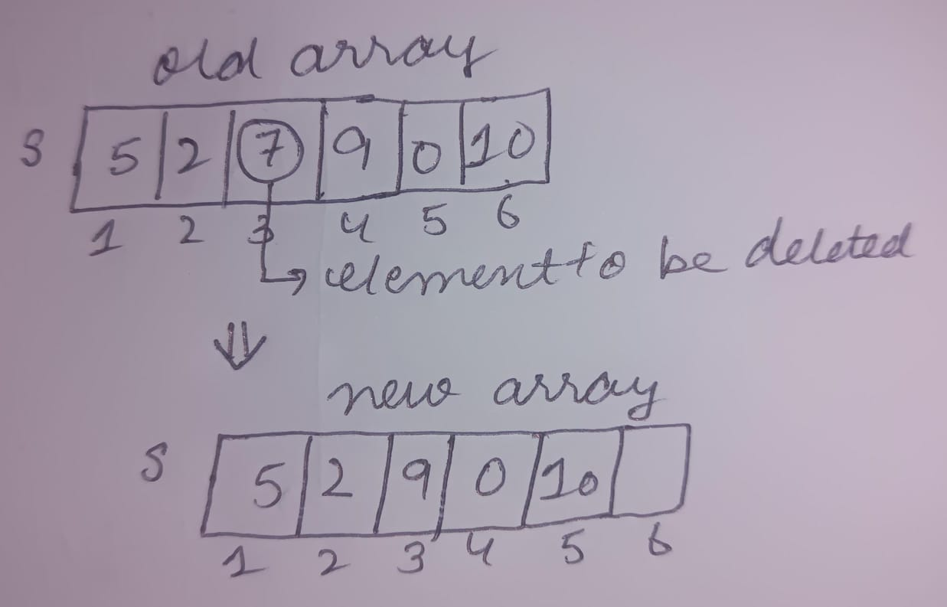
Algorithm
Step 1: Start
Step 2: Repeat steps 3 to 4 for i = k to n-1
Step 3: Set S[i] = S[i+1]
Step 4: Set i= i+1
[End of loop]
Step 5: Set n = n-1
Step 6: Exit
where, n= Size of an array
k=position from where we want to delete an element

Slide 20
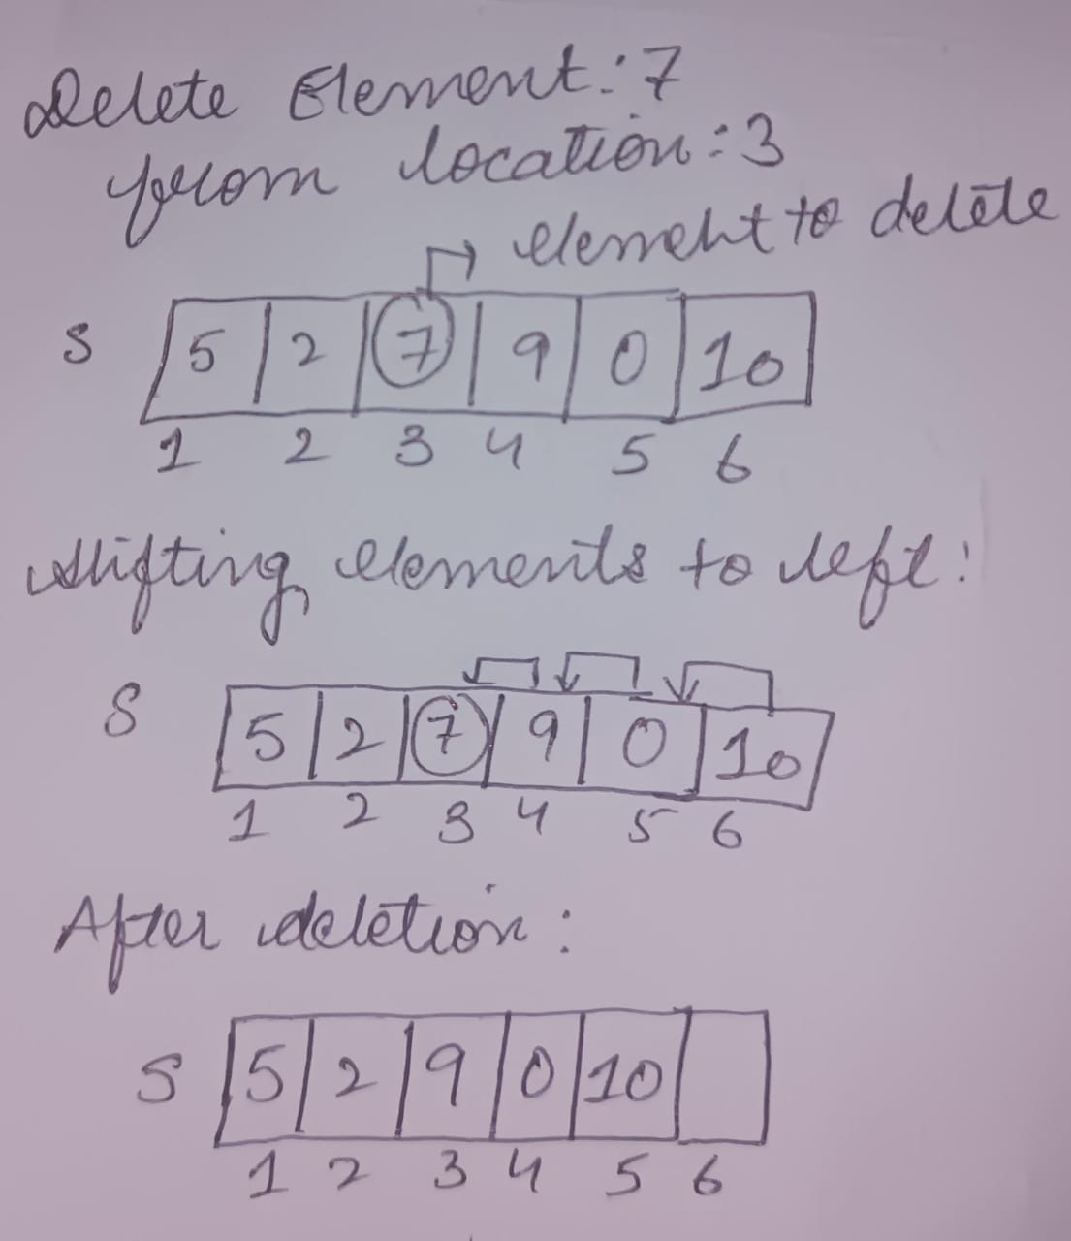
Working

Slide 21
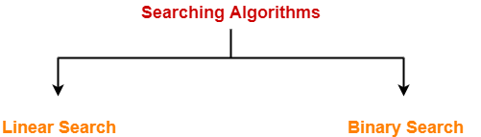
Searching
Searching is an operation which means to find a specific element within an existing array.
The element may or may not be present in the array.
Types of searching algorithms:

Slide 22
Linear Search:
The linear (or sequential) search algorithm on an array :
Start from beginning of an array/list and continues until the item is found or the entire array/list has been searched.
Sequentially scan the array, comparing each array item with the searched value.
Linear search can be applied to both sorted and unsorted arrays.

Slide 23
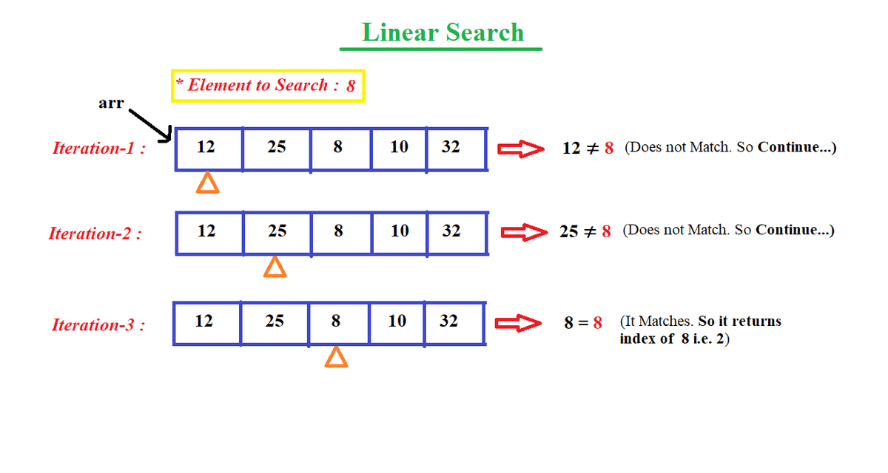
Example

Slide 24
Algorithm for linear search:
STEP 1: Start
STEP 2: Repeat steps 3 and 4 for I = 1to n
STEP 3: If S[i] = DATA then
Printf “Element is found at position”
Exit
[Endif]
STEP 4: Set i = i+1
[End loop]
STEP 5: Print “Desired element is not found in array”
STEP 6:Exit

Slide 25
Performance Analysis
Time complexity:
Best case : O(1) , Element present at beginning of an array.
Average case :O(n) , Element may be present somewhere in the middle.
Worst case :O(n) , Element at last or may not be in the array.
Space complexity : O(1)

Slide 26
Binary search
Binary search algorithm is efficient if the array is sorted.
A binary search is used whenever the list starts to become large.
It is an example of Divide and Conquer approach.
The binary search starts by testing the data in the element at the middle of the array to determine if the target is in the first or second half of the list.
If it is in the first half, we do not need to check the second half.
If it is in the second half, we do not need to test the first half.
In other words we eliminate half the list from further consideration.
We repeat this process until we find the target or determine that it is not in the list.
To find the middle of the list, we need three variables, one to identify the beginning of the list, one to identify the middle of the list, and one to identify the end of the list.

Slide 27
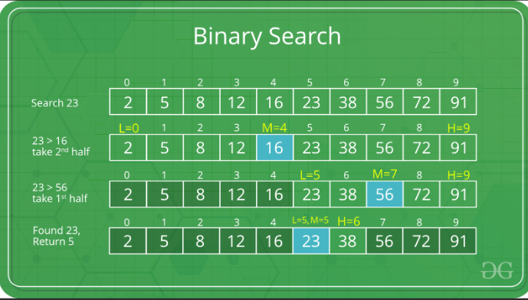
Example

Slide 28
Algorithm
STEP 1:Start
STEP 2: Set Start = lb
End = ub
STEP 3:Repeat steps 4 to 6 while Start <=End
STEP 4:If S[middle] = Integer[(start + end)/2]
STEP 5: If S[middle] = DATA then
Print “Element is found at position”
Exit
[Endif]
STEP 6: If middle < DATA then
Set start = middle +1
Else
Set end = middle -1
[Endif]
[End loop]
STEP 7: Print “Desired element doesn’t exist in array”
STEP 8: Exit

Slide 29
Performance Analysis
Time Complexity :
Best case : O(1), found in middle
Average case :O(log n) , Element is present in either of subarray.
Worst case : O(log n), Element is present in either of subarray.
Space complexity : O(1)

Slide 30
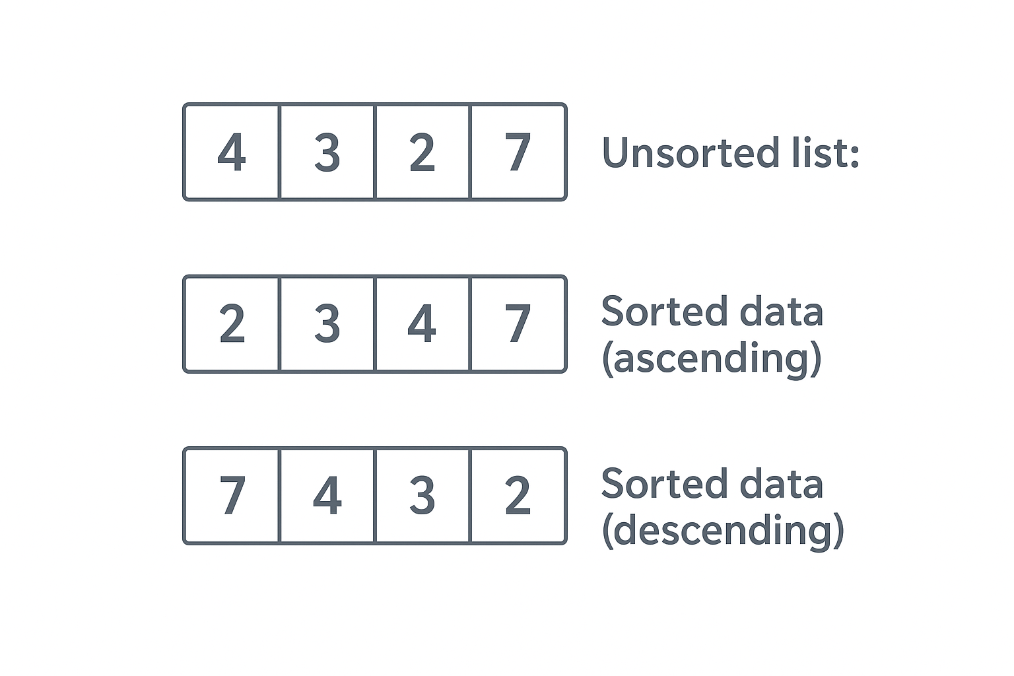
Sorting
Sorting an array means to rearrange the elements of an array in a certain order.
The elements can be arranged either in ascending or in descending order.

Slide 31
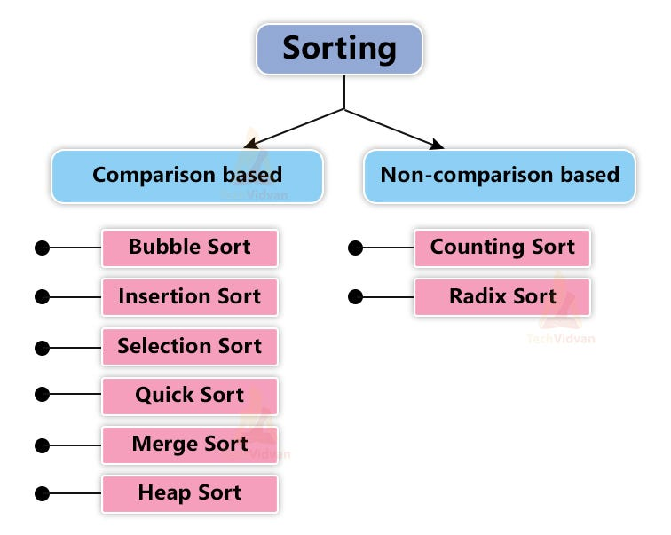
Types of Sorting Algorithms

Slide 32
Bubble Sort
In Bubble Sort, each element is compared with its adjacent element.
If the first element is larger than the next, their positions are swapped.
Otherwise, the position of the elements is not changed.
This process continues until the entire array is sorted.
Algorithm:
for (i = n; i > 1; i--)
for (j = 1; j < i - 1; j++)
if (a[j] > a[j+1])
{ // swap
t = a[j]
a[j] = a[j+1]
a[j+1] = t
}

Slide 33
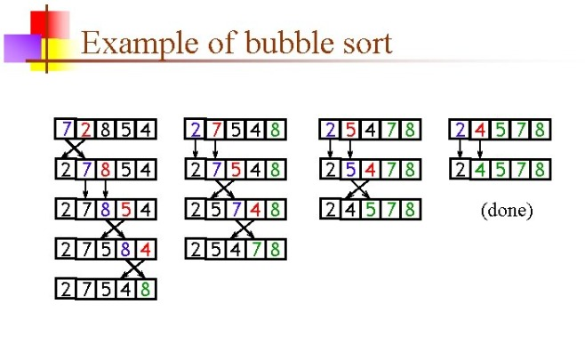
Example
Consider an unsorted array: [7,2,8,5,4]

Slide 34
Performance Analysis
Time Complexity:
T(n) = (n - 1) + (n - 2) + ... + 1
= n(n - 1) / 2
= O(n²)
Case-wise Time Complexity
Best Case (Already Sorted): O(n)
Average Case: O(n²)
Worst Case (Reverse Sorted): O(n²)
Space Complexity: O(1) (In-place sorting)

Slide 35
Time and Space Complexity Analysis of Array operations:
Operation | Best Case | Average Case | Worst Case | Space Complexity
Traversal | O(n) | O(n) | O(n) | O(1)
Insertion | O(1) (at end) | O(n) | O(n) (at beginning/middle) | O(1)
Deletion | O(1) (last element) | O(n) | O(n) (first/middle element) | O(1)
Searching (Linear) | O(1) (match at start) | O(n) | O(n) | O(1)
Searching (Binary) (sorted array) | O(1) | O(log n) | O(log n) | O(1)
Sorting – Bubble Sort | O(n) (already sorted) | O(n²) | O(n²) | O(1)

Slide 36
Advantages of Array
Better cache performance
Easy traversal
Fast element access (O(1))
Simple to implement
Good for static data sets

Slide 37
Disadvantages of Array
No automatic resizing
Cannot store different data types
Wastage of memory if not fully utilized
Insertion/deletion costly due to shifting
Fixed size (cannot grow/shrink)

Slide 38
Applications of Arrays
Searching & sorting algorithms
Storing data in tabular form (matrices)
Lookup tables
Image processing (pixels)
Stacks, queues, heaps, hash tables (implemented using arrays)

Slide 39

Thank You

